Slide 1
Multiple Linear Regression

Slide 2
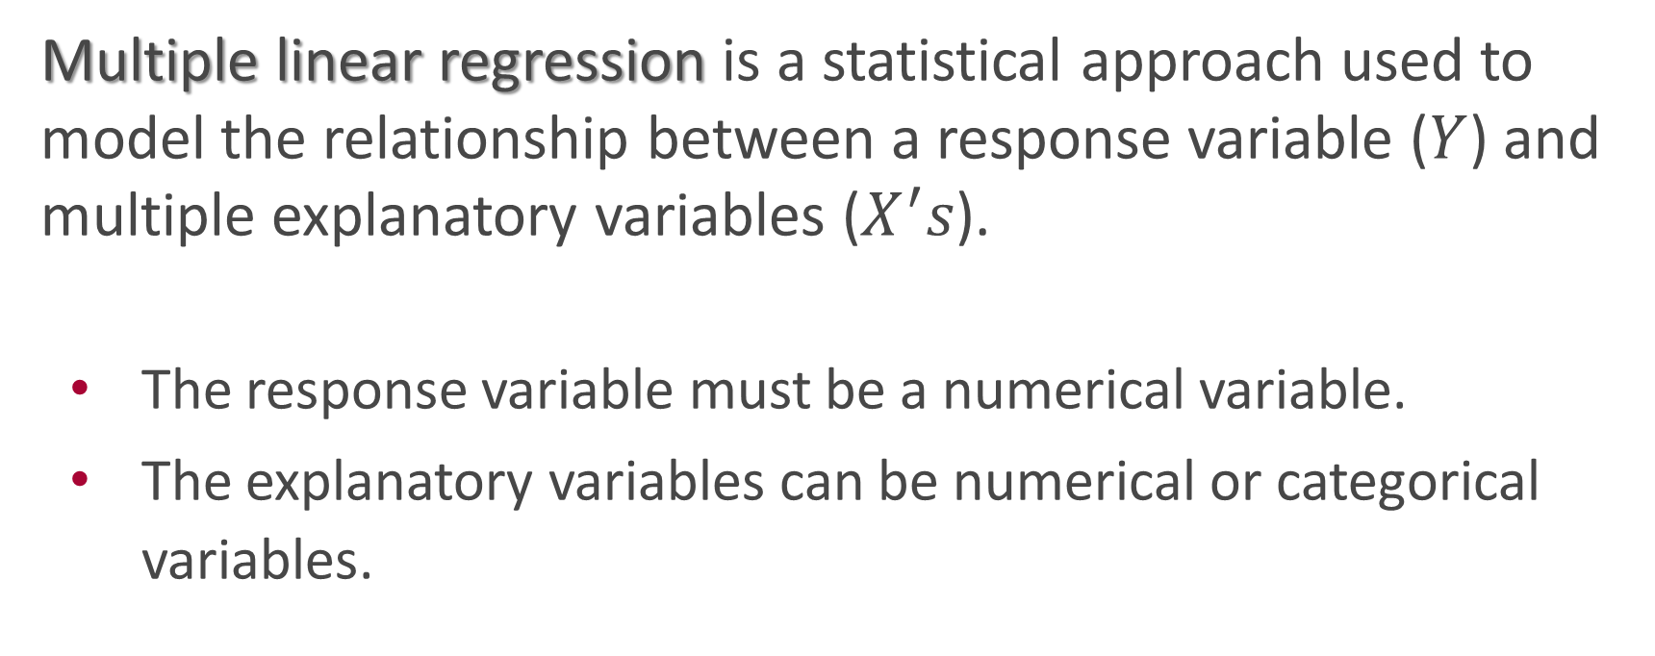
Multiple Linear Regression:
Multiple linear regression is a statistical approach used to model the relationship between a response variable ($Y$) and multiple explanatory variables ($X^{′}s$).
The response variable must be a numerical variable.
The explanatory variables can be numerical or categorical variables.

Slide 3
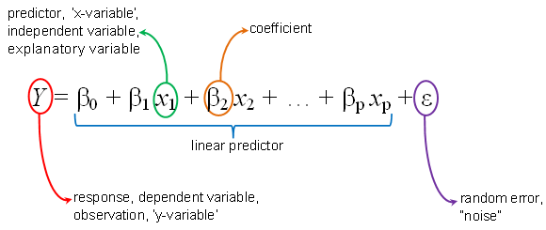

Multiple Linear Regression:
The multiple regression model can be rewritten as
wherer $β_{0}$ is called the intercept, $β_{i}^{′}s$ are called the regression coefficients, and $ε$ is called the error term.

Slide 4
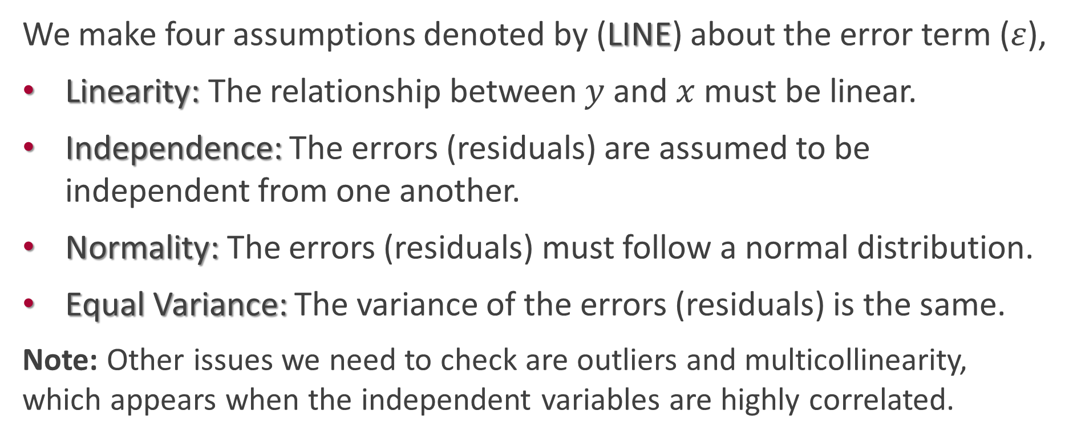
Linear Regression Assumptions:
We make four assumptions denoted by (LINE) about the error term ($ε$),
Linearity: The relationship between $y$and $x$must be linear.
Independence: The errors (residuals) are assumed to be independent from one another.
Normality: The errors (residuals) must follow a normal distribution.
Equal Variance: The variance of the errors (residuals) is the same.
Note: Other issues we need to check are outliers and multicollinearity, which appears when the independent variables are highly correlated.

Slide 5
Polynomial Regression:
Polynomial regression a form of linear regression models where the relationship between a response variable and an explanatory variable is modeled as a polynomial function.
It is necessary because linear regression cannot capture curved relationships.
Quadratic regression is a type of polynomial regression that fits a quadratic function (a parabola – second degree polynomial).
Cubic regression is a type of polynomial regression that fits a cubic function (third degree polynomial).

Slide 6
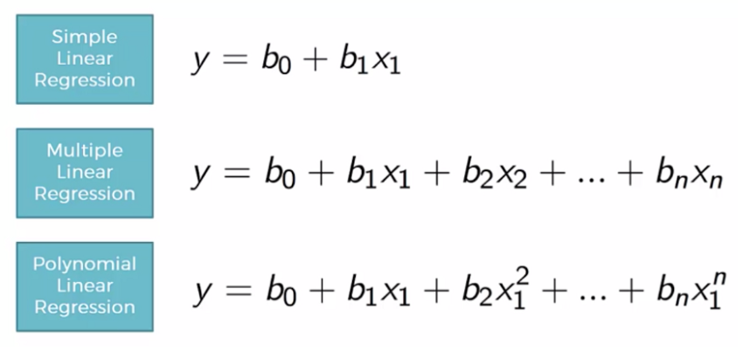
Figure 1 Comparison between simple, multiple, and polynomial linear regression

Slide 7
Multiple Linear Regression with Categorical Predictors:
It is used when the model incorporates categorical explanatory variable(s) that represents groups (categories), such as gender, region.
The categorical variable is transformed into several binary variables (0 or 1). This is called (dummy coding or one-hot encoding).
The number of new binary variables equals the number of categories minus one.

Slide 8
Types of Regression Models

Slide 9
Other Types of Regression Models:
There are many different types of regression models. Here are some of them:
Piecewise Regression: It is used in which the independent variable is divided into intervals and a separate line segment is fit to each interval.
Bayesian Regression: It is used Bayes' theorem to estimate regression coefficients instead of the ordinary least square method (OLS).
Quantile Regression: It is used the quantiles instead of just the average.
principal component regression: It is used to reduce high-dimensional data or multicollinear data.

Slide 10
Other Types of Regression Models:
Poisson Regression: Used to model count data, where the dependent variable represents the number of events occurring within a specific time or space.
Negative Binomial Regression: Used to model count and overdispersed data (the variance exceeds the mean).
Beta Regression: Used to model dependent variables that are continuous and constrained to the interval [0,1], such as proportions or percentages.
Gamma Regression: Used to model continuous and positive dependent variables.

Slide 11
Regularization Regression Models:
Lasso Regression (L1 Regularization): It can lead to variables selection by shrinking coefficients of less important variables to zero.
Ridge Regression (L2 Regularization): It is used to prevent overfitting, especially when dealing with multicollinearity.
Elastic Net Regression: It combines both Lasso (L1) and Ridge (L2) regression to provide a balance between feature selection and model complexity.

